Slide 1

Frontend programming
Alpha Amadou DIALLO
Software & DevOps Engineer | Fintech lover

Slide 2
Introduction to Frontend Development
Notes:
What is frontend development, Why should you learn it, where is it used?

Slide 3
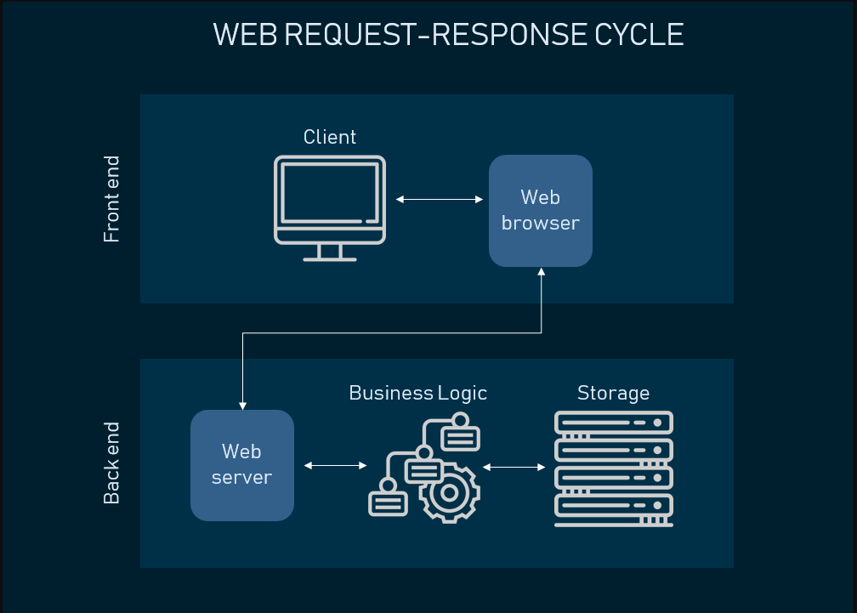

Slide 4
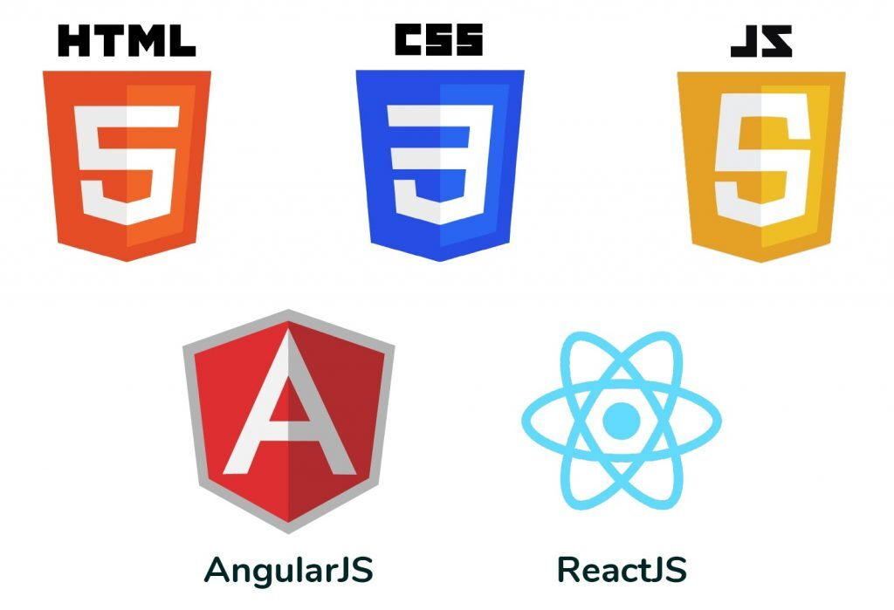
Tools used for front-end development

Slide 5
HTML
HTML (Hypertext Markup Language) is the standard markup language used to create and display web pages in a web browser.
It is not a programming language
It uses tags to define elements of a webpage's user interface (UI).
Tags are enclosed in angle brackets (< >)
Most HTML elements have an opening tag and a closing tag. The closing tag includes a forward slash (/).
Tags can have attributes, which provide additional information about the element.
HTML files are stored in the .html format.

Slide 6
CSS
CSS (Cascading Style Sheets) is the language used to describe the presentation of HTML elements.
It defines how HTML elements should be displayed on screens, paper, or other media.
It allows you to control the layout of multiple web pages simultaneously, greatly reducing repetitive work.
CSS styles are typically stored in external .css files, making it easier to manage and reuse styles across a website.

Slide 7
JAVASCRIPT
JavaScript (JS): A programming language used to create interactive and dynamic content on web pages (HTML).
Unlike HTML, It is a full-fledged programming language that can manipulate data, control the behavior of elements, and respond to user interactions.
It can respond to user actions, such as clicks or key presses, by executing functions or modifying the HTML and CSS of a webpage.
It enables real-time updates to the content and layout of a webpage without requiring a full page reload.
JS code is written using syntax rules, which include variables, functions, loops, and conditional statements.
JS code is typically embedded directly within HTML files using <script> tags or included through external .js files.

Slide 8
HTML - Hyper Text Markup Language

Slide 9
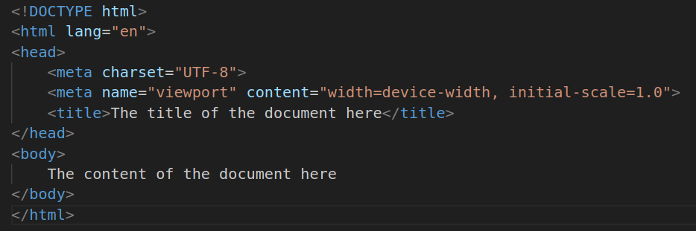
HTML Structure
Notes:
Explain the HTML structure, head and body tag and so on

Slide 10
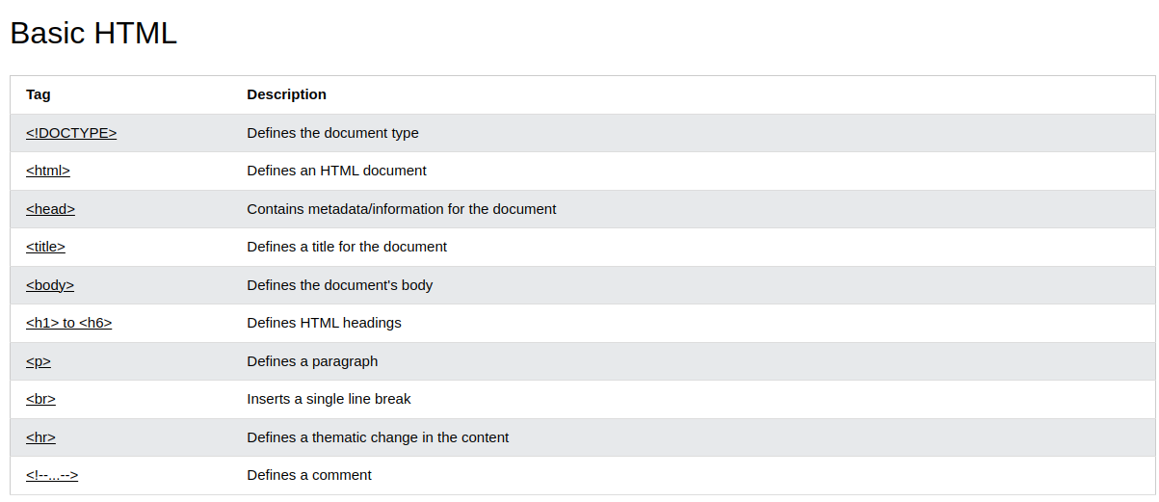
https://www.w3schools.com/tags/ref_byfunc.asp

Slide 11
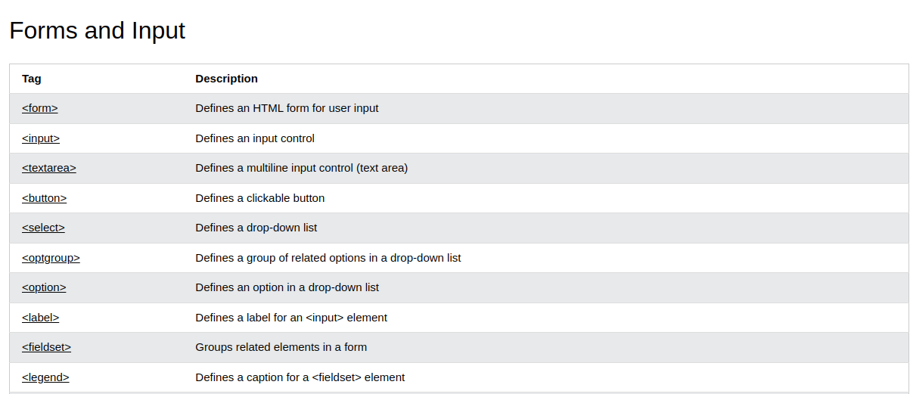
https://www.w3schools.com/tags/ref_byfunc.asp

Slide 12
CODING SESSION!

